Slide 1
100 | 150 | 100
50 | 80 | 90
70 | 120 | 110
Mean=(100+150+100+50+80+90+70+120+110)/9≈96.7

Slide 2
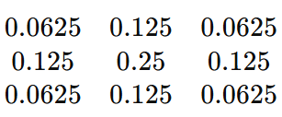
100 | 150 | 100
90 | 80 | 50
70 | 120 | 70
(100×0.0625) + (150×0.125) + (100×0.0625) + (50×0.125) + (80×0.25) + (90×0.125) + (70×0.0625) + (120×0.125) + (110×0.0625) ≈ 86

Slide 3
10 | 150 | 100
255 | 5 | 200
90 | 120 | 180
[5,10,90,100,120,150,180,200,255]

